Slide 1
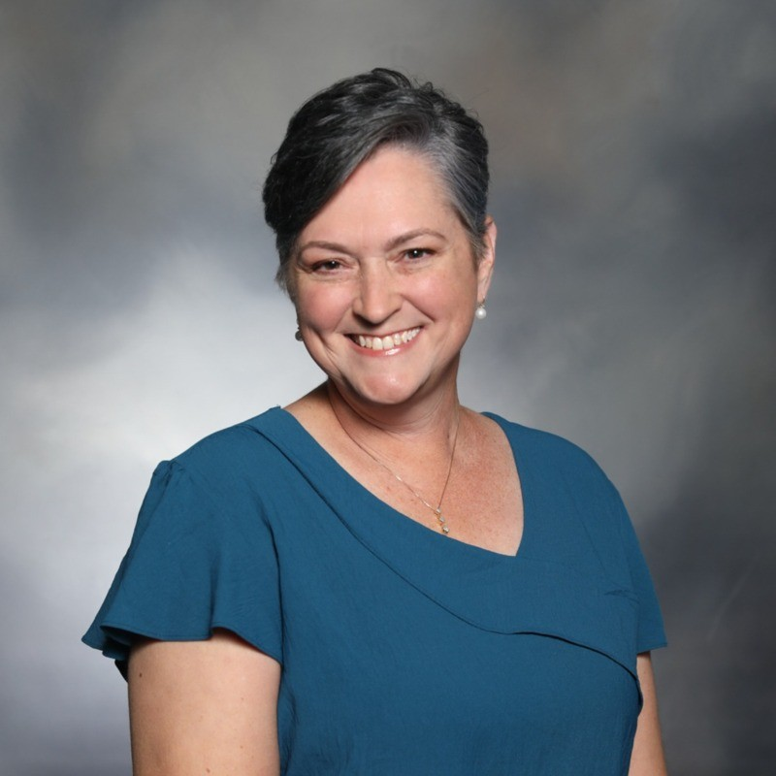
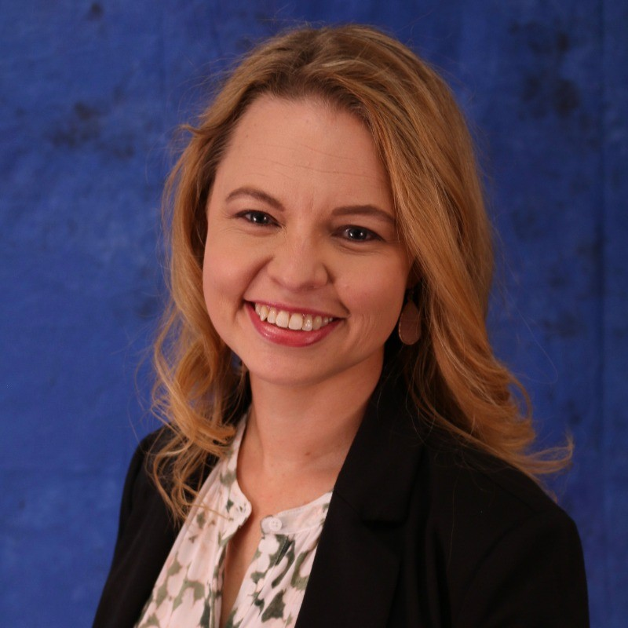
Veterinary Business Institute
Welcome to the Veterinary Technology & Innovation Panel
Webinar Title: When Tech Helps — and When It Hurts — the Human-Animal Connection
Notes:
Good evening everyone, and welcome to the Veterinary Technology & Innovation Panel: When Tech Helps — and When It Hurts — the Human-Animal Connection
This event is brought to you by the Veterinary Business Institute, and our goal tonight is to help practice owners like you move from just practicing medicine to running a truly thriving business. I am Chehara Bandara, your host for this session and Over the next hour, we'll be uncovering the often-overlooked factors that quietly impact your bottom line.

Slide 2
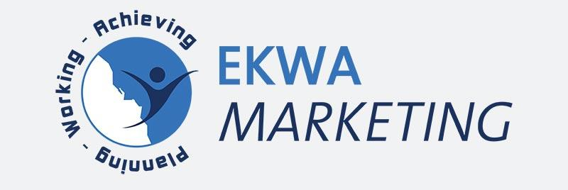
Platinum Sponsor – Ekwa Marketing
Our Platinum Sponsor, Ekwa Marketing, believes that great veterinary care deserves great visibility. For over 15 years, they’ve helped veterinary practices across USA, UK, Canada, Australia, Ireland & New Zealand connect with pet owners through expert SEO, dynamic social media campaigns, website design and strategic online marketing tailored specifically for the animal health industry. By leveraging data-driven insights and innovative digital tools, Ekwa Marketing empowers clinics to attract new clients, strengthen community relationships, and grow sustainably.
Learn More About Ekwa: www.ekwa.com
Notes:
And this essential conversation is made possible by our wonderful sponsor, Ekwa Marketing. In today's digital world, building a practice that truly connects with your community and drives growth requires a clear, strategic marketing plan. Ekwa Marketing specializes in helping veterinary practices do just that, and they've got a special thank you for you later that you don't want to miss.

Slide 3
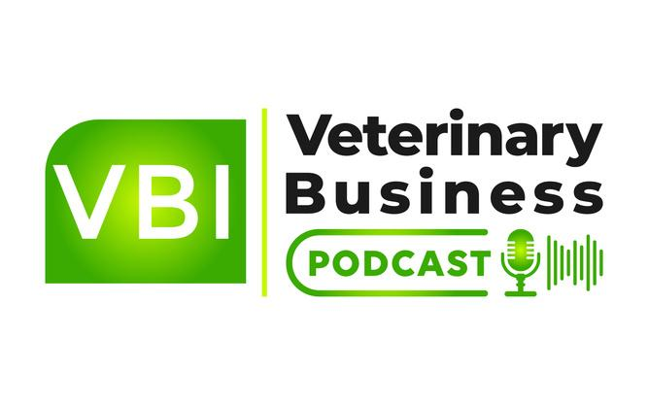
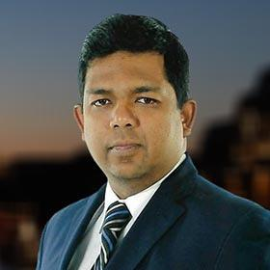
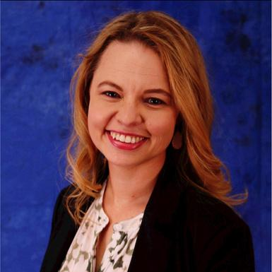
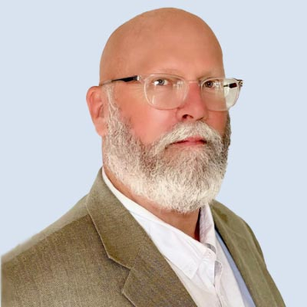
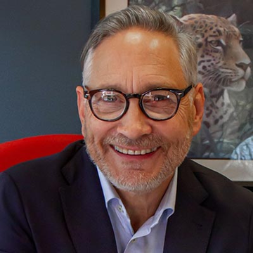
Veterinary Business Podcast
Every Thursday @ 5:00 AM ET
What Do We Cover:
Practice Management
Financial Management
Marketing and Branding
Technology and Innovation
Industry Trends and Insights
Staff Training and Development
Legal and Regulatory Compliance
Client Experience and Satisfaction
Client Communication and Education
Community Engagement and Outreach
Sustainability and Environmental Practice
Ethical Dilemmas and Professional Standards
Naren Arulrajah
Dr. Amanda Landis-Hanna
Dr. Mark Roozen
Dr. Joel Parker
Notes:
The conversation we're having tonight doesn't have to end in an hour. It continues every week on the Veterinary Business Podcast.
Our mission is simple: to bring you actionable business insights from industry leaders to bridge the gap between medicine and management. New episodes drop every Thursday morning at 5 AM Eastern.
Just search for 'Veterinary Business Podcast' wherever you listen, and be sure to subscribe.

Slide 4
Veterinary Business Institute’s
Annual Expert Panel Webinar
Veterinary Technology & Innovation Panel: When Tech Helps — and When It Hurts — the Human-Animal Connection
Notes:
So without further ado, let's get to know our experts.

Slide 5
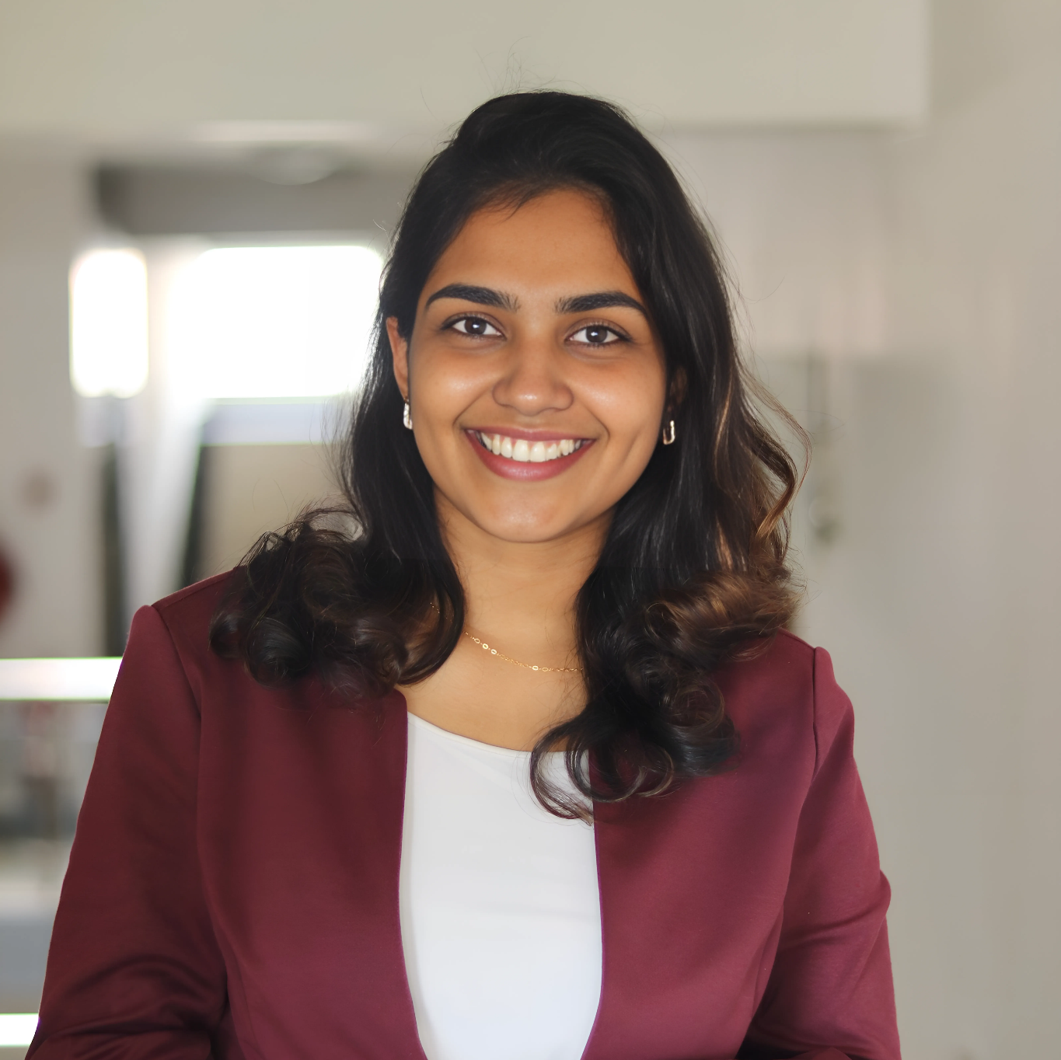
Moderator
Chehara. B
Manager, Live Events & Summits
Chehara brings expertise in people development and event leadership to her role as Manager of Live Events & Summits at the Veterinary Business Institute, where she curates impactful educational experiences designed to inspire and engage veterinary professionals across diverse practice settings.
With a strong academic foundation in Psychology and Human Resource Management, Chehara is passionate about creating spaces where professionals can connect, learn, and grow together. Her work focuses on blending strategic event planning with human-centered design to ensure every session delivers both value and inspiration.
Beyond her role at VBI, Chehara is committed to initiatives that foster leadership, engagement, and positive societal impact. She believes in the power of community-driven learning and strives to bring people together in ways that spark meaningful change.

Slide 6
Rhonda Bell
Rhonda Bell, CVPM, PCM-Digital, CDMP, is a seasoned veterinary practice management expert and the founder of Dog Days Consulting. With over 20 years of experience in veterinary leadership and digital strategy, she empowers practices to build meaningful client relationships while navigating the demands of modern technology. Rhonda’s work highlights the importance of balancing efficiency with authentic connection, cautioning against the risks of over-relying on technology in client relationship building.
Her coaching and speaking engagements help veterinary teams integrate digital tools thoughtfully, without sacrificing the human element that drives trust and compliance.
Notes:
First, let's welcome
Rhonda Bell is a seasoned veterinary practice management expert and the founder of Dog Days Consulting. With over 20 years of experience in veterinary leadership and digital strategy, she empowers practices to build meaningful client relationships while navigating the demands of modern technology. Rhonda’s work highlights the importance of balancing efficiency with authentic connection, cautioning against the risks of over-relying on technology in client relationship building.

Slide 7
Amanda Landis-Hanna
Veterinary thought leader with expertise in technology, innovation, veterinary and consumer engagement, and project management. Special focus on nonprofit management, relationship development, research, veterinary education models, advocacy, and accessible veterinary care. Skilled public speaker, strategist and mentor with experience in hands-on practice, social media and content production.
Notes:
Next, we have Amanda Landis-Hanna. Veterinary thought leader with expertise in technology, innovation, veterinary and consumer engagement, and project management. Special focus on nonprofit management, relationship development, research, veterinary education models, advocacy, and accessible veterinary care. Skilled public speaker, strategist and mentor with experience in hands-on practice, social media and content production.

Slide 8
Main points for today's discussion:
The benefits of telemedicine and remote monitoring
The risks of over-reliance on automation in client interactions
How to balance efficiency with a personal touch
Training staff to use tech tools while keeping empathy at the forefront
How technology can improve compliance and patient follow-up
Notes:
"Here are the main points for today's discussion:
We'll explore the benefits of telemedicine and remote monitoring.
We'll cover the risks of over-reliance on automation in client interactions.
We'll discuss how to balance efficiency with a personal touch.
We'll talk about training staff to use tech tools while keeping empathy at the forefront.
And finally, we'll look at how technology can improve compliance and patient follow-up."

Slide 9

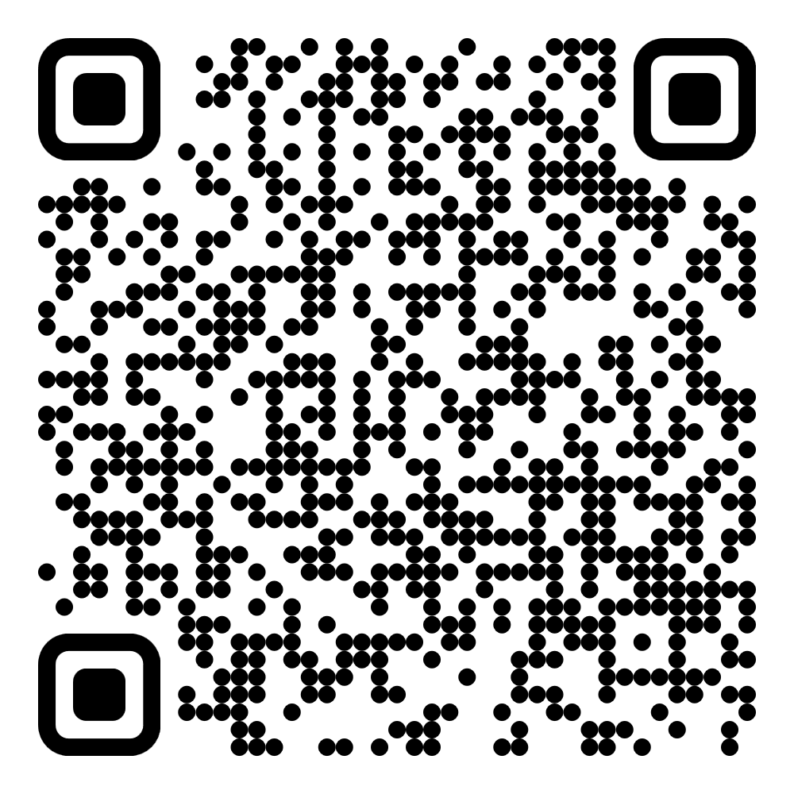
🎉 Thank You for Joining Us Today!
As a token of our appreciation, we’re thrilled to offer you an exclusive gift valued at $900. 🗓️ A Free Marketing Strategy Meeting with Lila Stone, Veterinary Marketing Consultant and Marketing Advisor of Ekwa Marketing & Veterinary Business Institute
Visit https://www.veterinarybusinessinstitute.com/msm/ and Book a Session at your convenience. Lila is Specialized in helping :
General Veterinary Practice
Specialty Veterinary Practice
Emergency and Critical Care Centers
Exotic Animal Practices
Equine Veterinary Practices
Mixed Animal Practices
Holistic Veterinary Practices
Mobile Veterinary Services
Research and Teaching Hospitals
Rehabilitation and Physical Therapy Centers
Notes:
Rhonda and Amanda, thank you for that fantastic discussion. And as a token of our appreciation for all of you joining us today, we’re thrilled to offer an exclusive gift valued at $900. It's a Free Marketing Strategy Meeting with Lila Stone, a Veterinary Marketing Consultant for Ekwa Marketing and the Veterinary Business Institute. Lila specializes in helping practices just like yours, from General and Specialty to Mobile and more. Please use the link or scan the QR code to book your session at your convenience."

Slide 10
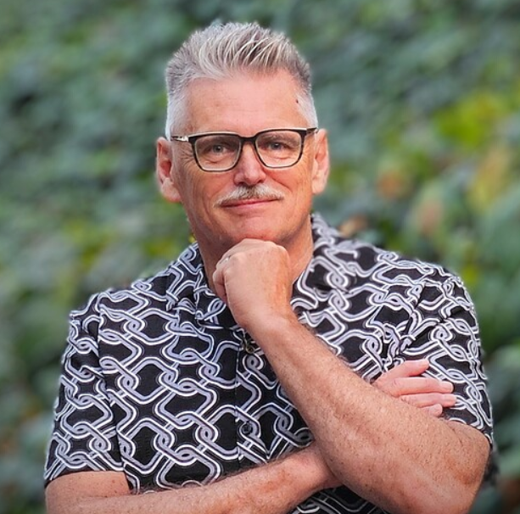
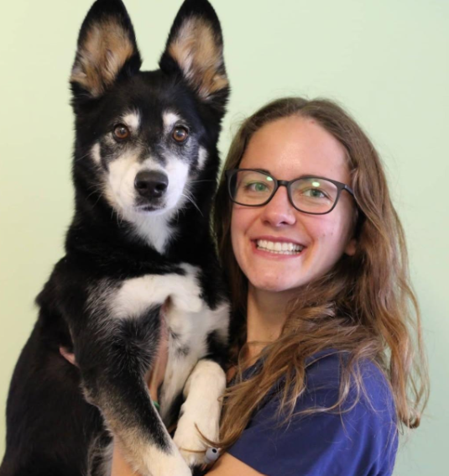
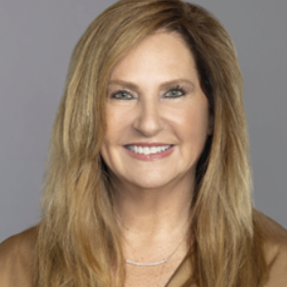
Veterinary Business Institute
Thank You
Notes:
Panel, thank you for an incredibly insightful hour. Let's see if we have any questions from our audience… As we close, I want to remind you one last time about the free marketing strategy session. If you identified an area for improvement, this is your chance to get a customized, expert-led plan to fix it. The link is in the chat. "That is all the time we have for tonight. A huge thank you to our expert panelists, Rhonda Bell and Dr. Amanda Landis-Hanna, for their incredible insights. And to our wonderful audience, thank you for your time and engagement. On behalf of the entire Veterinary Business Institute, I'm Chehara Bandara. Goodnight, everyone."

